Slide 1
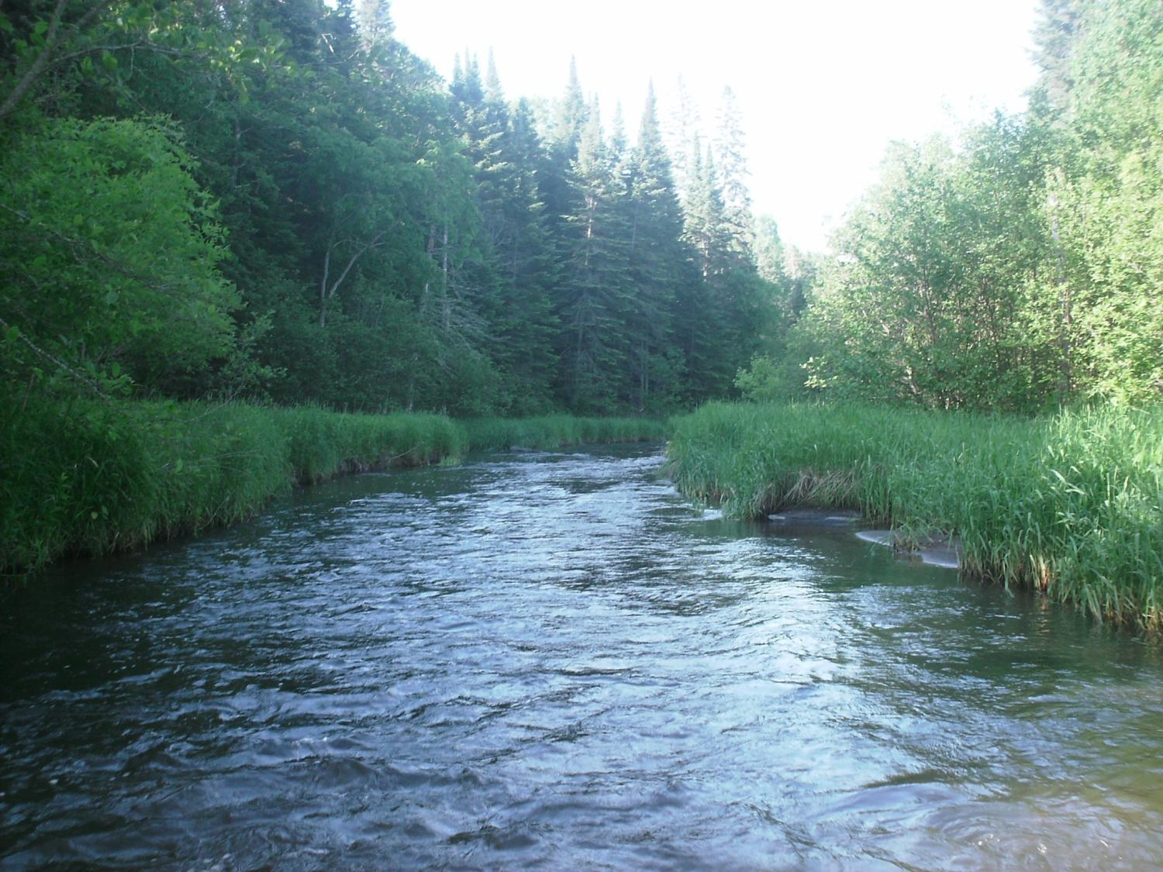
Legislative Water Commission
April 23, 2018
Co-chairs: Senator Wiger Representative Torkelson
Jim Stark, Director
Straight River, Becker County
1

Slide 2
Agenda
Approve minutes -- March 26
Geologic atlas program
Clean Water Fund: performance report
2018 LWC recommendations
2019 LWC process
Summer tour
Updates on water legislation
Next meetings: June 19

Slide 3
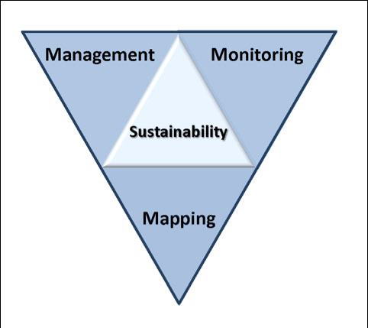
Issue Presentation: Geologic Atlas Program
Dale Setterholm– Minnesota Geological Survey
Paul Putzier– DNR
Ray Wuolo- Barr Engineering
Notes:
Protection of ground water and surface water resources will require substantial investments from a diversity of funding sources over all levels of government during the next decade. As a part of this effort, this program of mapping, monitoring and managing is necessary to deliver the basic understanding of the hydrologic system for both surface and groundwater.

Slide 5
County Geologic Atlas Program
Dale Setterholm
Minnesota Geological Survey
University of Minnesota

Slide 8
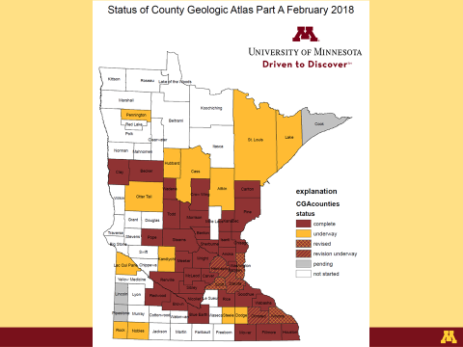

Slide 10
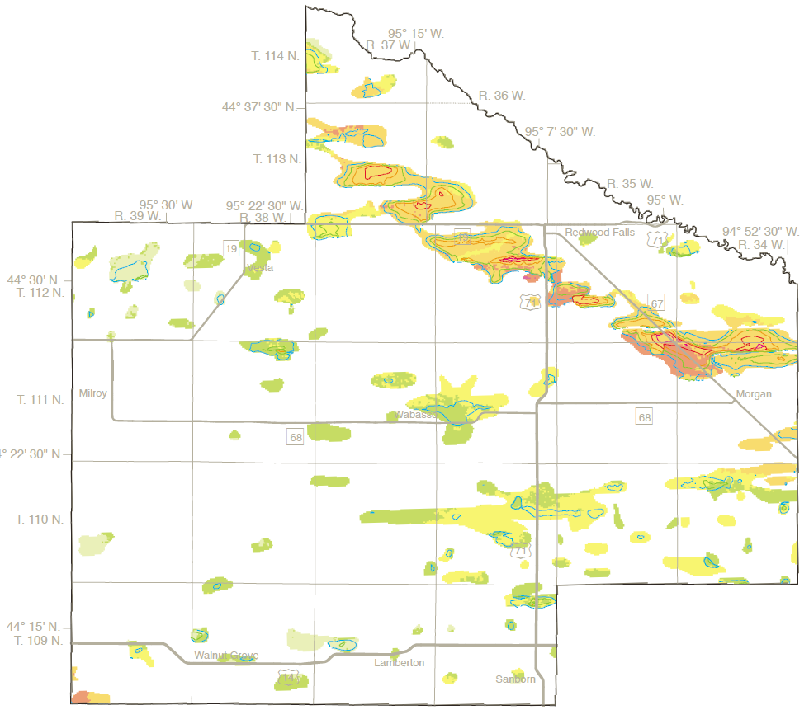

Slide 17
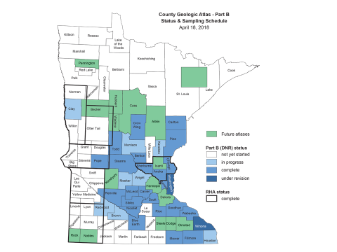

Slide 18
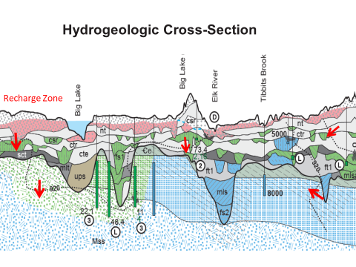

Slide 19
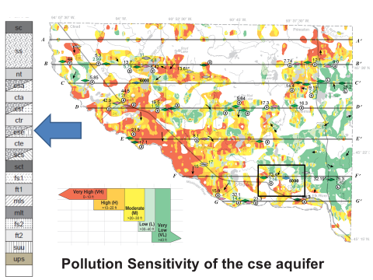

Slide 20
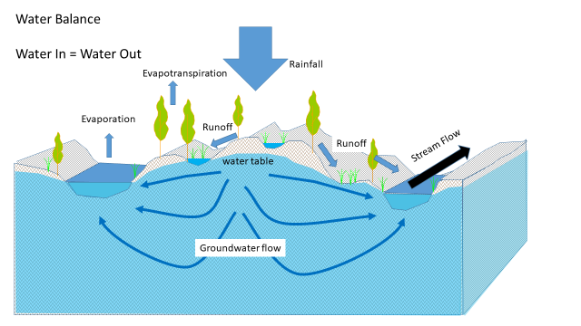

Slide 21
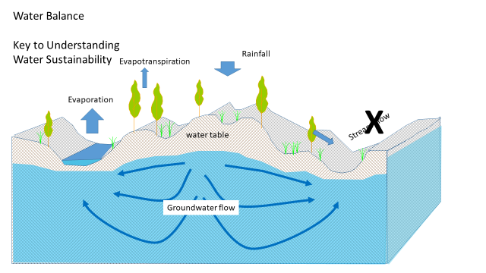

Slide 23
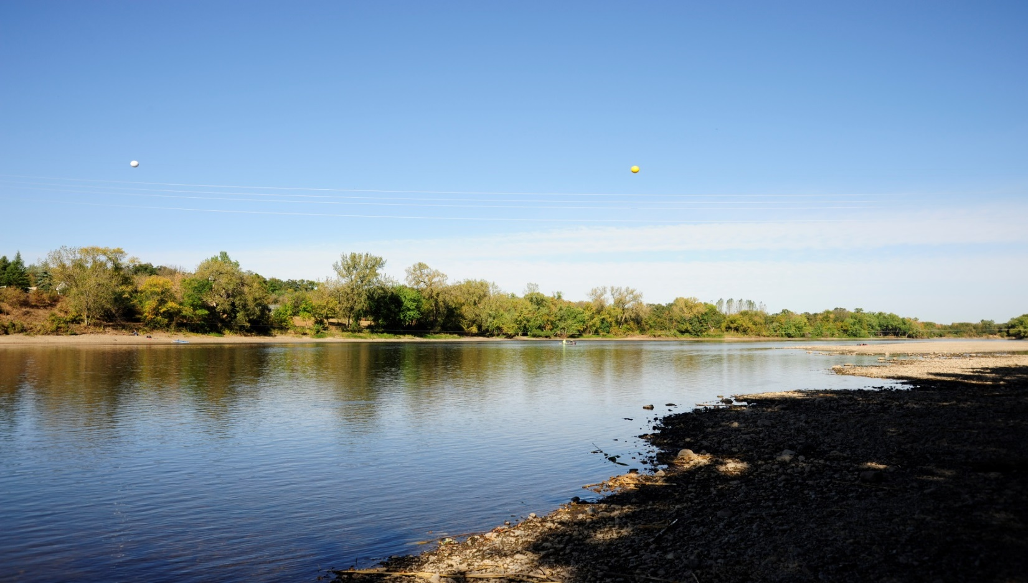
Clean Water Fund Performance
Mississippi River at Clearwater, MN (September 2012)

Slide 24
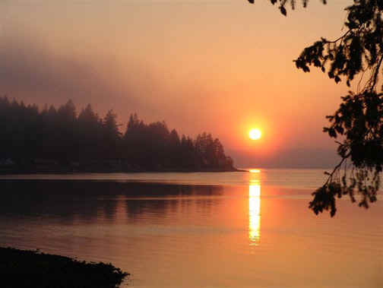
CWF FY18-19-- Funding
Implementation: $105 M
Planning/Tech Assist. $67 M
Monitoring/Mapping/Data: $41 M
Research/Evaluation $8 M
Total: $221 M/biennium
Emphasis on impaired water
Entire state assessed
Focus on local implementation
Notes:
For more information and real time monitoring data you can visit this web site.

Slide 25
CWF Goals and Expectations - 2034
Lake Quality: + 7-8%
Acceptable Lake Tropic Status: from 62% to 70%
Rivers: Fish IBI: from 60% to 67%
Wells-arsenic standard: (reduce by 50%)
Wells: nitrate standard (reduce by 20 %)
GW declines (less than 10% declining)

Slide 26
Progress and Citizen Expectations
Improvements seem small ?
Lag-time
External drivers: (land use, climate, economy, trade, population)
2034 is coming/Citizen expectations
Can outcomes be improved?
Can LWC support additional change?

Slide 27
Minnesota’s Water Quality Improvement Goal
#25by25MN
Katie Pratt
Director of Communications and Public Engagement
katie.pratt@state.mn.us

Slide 28
Citizens Said:
+ Education and engagement
+ Water retention
+ More GOV/public involvement
+ Local planning
Focus on drinking water
Reduce salt
Inadequate septic systems
Focus funding
Focus on incentives

Slide 29
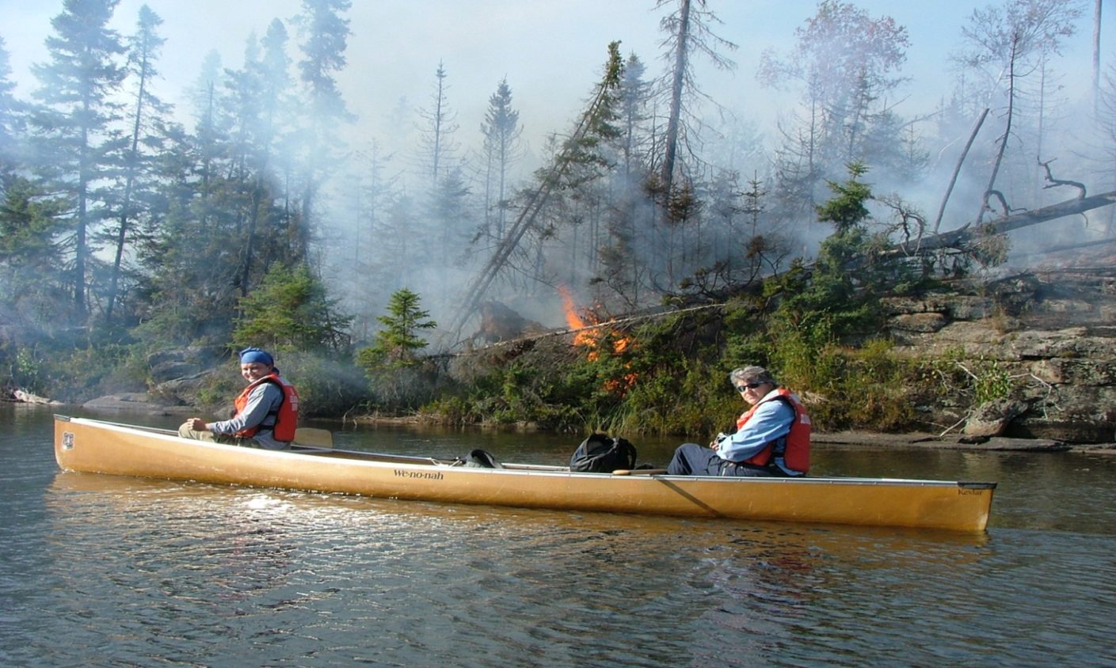
2019 Focus for the LWC Recommendations-2018
From a sustainability perspective, a key point is that decisions today may not be fully realized for many years

Slide 30
LWC Legislative Recommendations 2018
Alternatives for WWTPs
Peer review of waste-water standards
Promote WWTP efficiency/alternatives
PFA Bonding request $167M

Slide 31
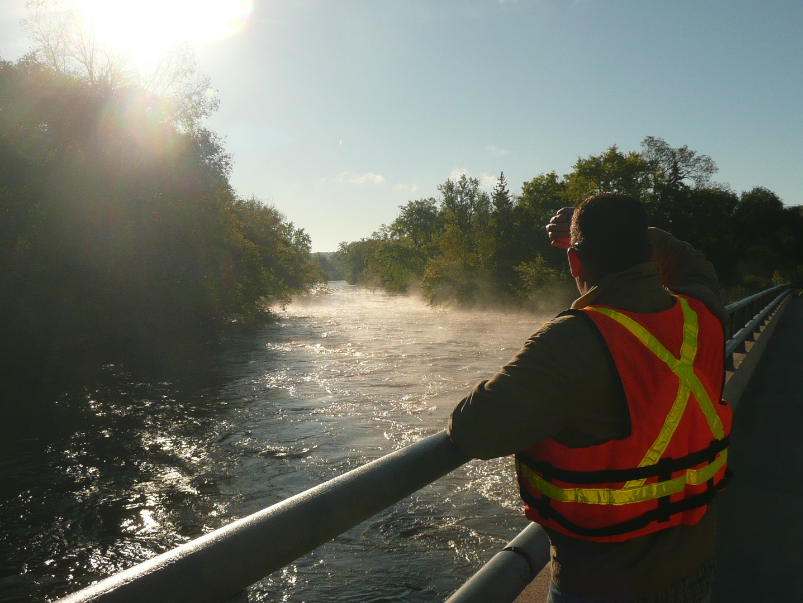
Agenda: Discussion--2019 LWC Process
31

Slide 32
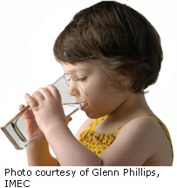
2019 LWC Recommendation Discussion
Water trading- Storm water for wastewater
Water for the future
Water retention
Private wells
Public drinking water
Evaluate past BMPs
Evaluate water management
Many more………………..
Notes:
What we hope to leave you with is a much better understanding of our state’s groundwater resources and appreciation for the challenges we face.
Simply stated the problem we are increasingly recognizing is that there are ….

Slide 33
Schedule 2019?
Issues with narratives: April
LWC Consensus--top 3: after session (short and long term issues)
Expert input: summer
Recommendation by issue: Fall
Recommendation consensus: Fall
Document to support legislation: (December)
Notes:
For more information and real time monitoring data you can visit this web site.

Slide 34
Discussion: LWC summer issue tour - One day? - Select an issue: * Water retention/infiltration * Lakes with problems * Drinking water * Groundwater/surface water * Others? Poll LAs for possible dates Watch for email
34

Slide 35
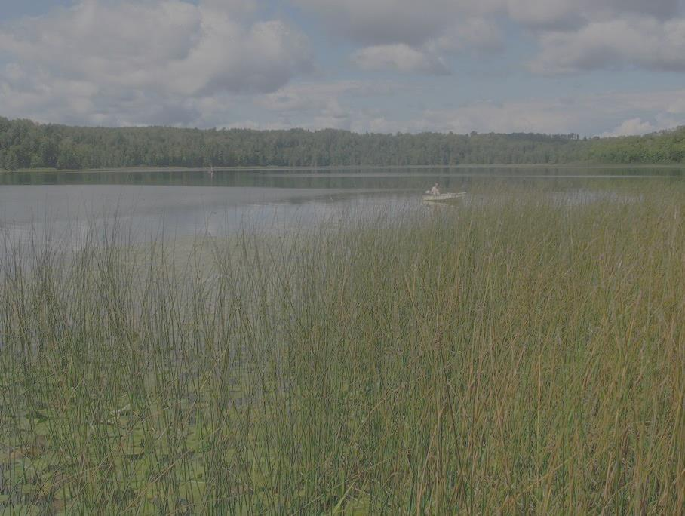
Updates on Water Legislation Announcements:
Water Day at the Capitol

Slide 36
Thanks
The well was dry beside the door, And so we went with pail and can Across the fields behind the house To seek the brook if it still ran.
“Going for Water”-- Robert Frost
Notes:
For more information and real time monitoring data you can visit this web site.

